Slide 1
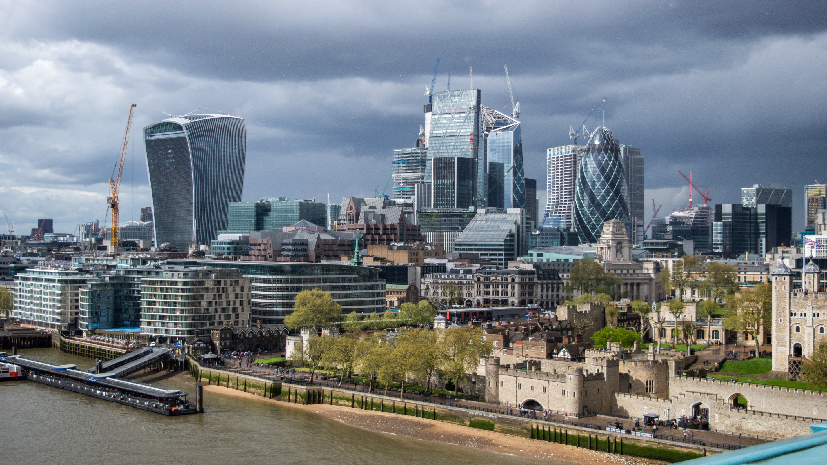
Slide 1
IBM-Coursera
Applied Data Science Assignment
The Battle of Neighborhoods
June, 2020
Pic Source: By Tristan Surtel - Own work, CC BY-SA 4.0, https://commons.wikimedia.org/w/index.php?curid=83153416

Slide 2
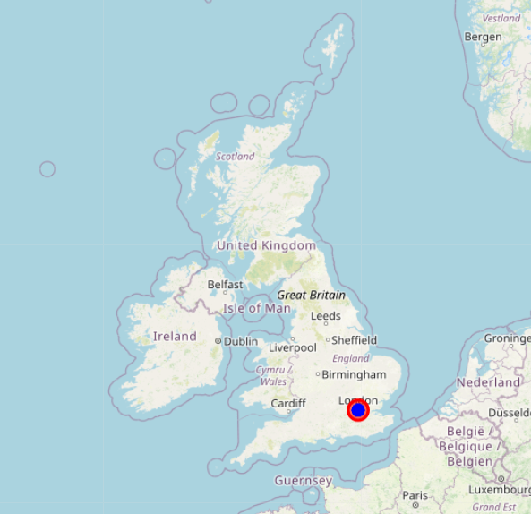
Introduction
London is the capital and largest city of England and the United Kingdom. London has been a major settlement for two millennia.
London is considered to be one of the world's most important global cities and has been called the world's most powerful, most desirable, most influential, most visited, most expensive, sustainable, most investment-friendly, and most-popular-for-work city.
London also has largest financial institutions and is also home to top-ranked universities in the world. (Wiki)
2

Slide 3
Problem Description
London has always been a dream city for me personally to move and live there.
To move to such a vibrant city, one of the main concerns is to find good affordable accommodation in a safe neighborhood.
Therefore in this project, I intend to explore London neighborhoods and find the best the neighborhood to move in.
Through this project, I would like to get to know the safest borough (less crime rate as one of main factor) and its neighborhoods venues.
This project could potentially help other people who have similar interests to move to London and live there.
3

Slide 4
Data Description
To get the desired results, following data sources will be used.
London Recorded Crime (Crime Data)(Last 24 months data is considered for evaluation)
List of London Boroughs (List)
Foursquare APIs are used too explore neighborhoods and target different venues according to the presence of needed facilities.
The data is stored in the data frame and used for visualization.
4

Slide 5
Analyzing Data – Crime Data
5

Slide 6
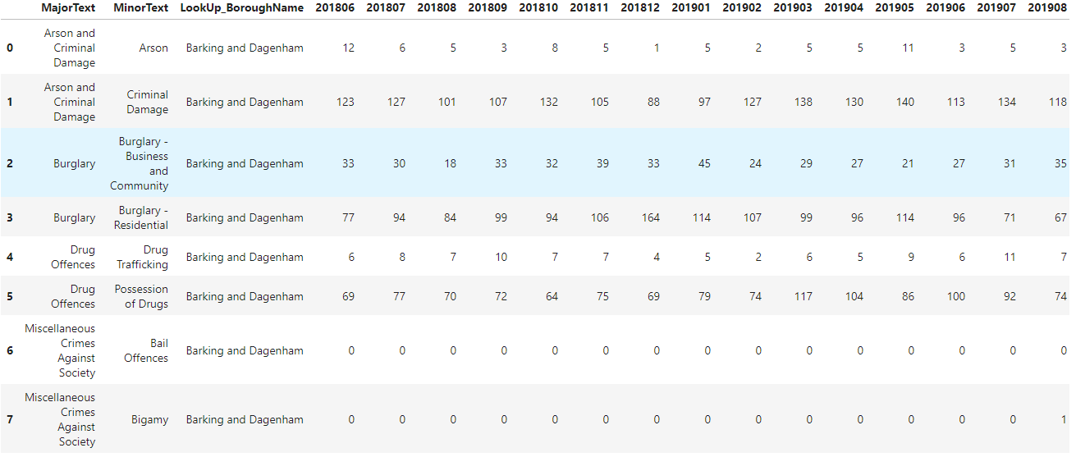
Slide 2
London Crime Data
Data from last 24 months
Data Size: (1566, 27)
6

Slide 7
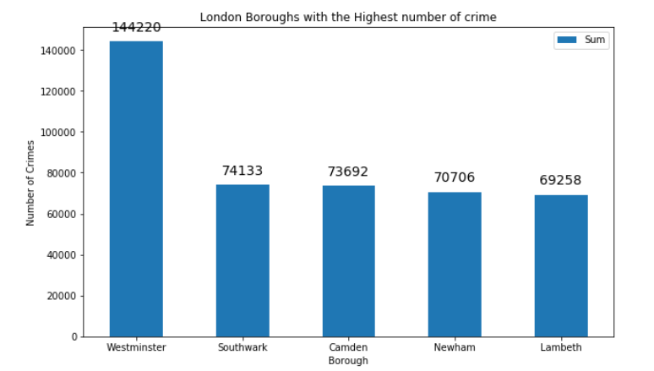
Slide 2
Top 5 Boroughs with highest crime incidents
Graph shows top 5 boroughs with crime rate
Westminster has highest crime rate (probably due to more touristic attractions in the Borough) followed by Southwark , Camden, Newham and Lambeth.
7

Slide 8
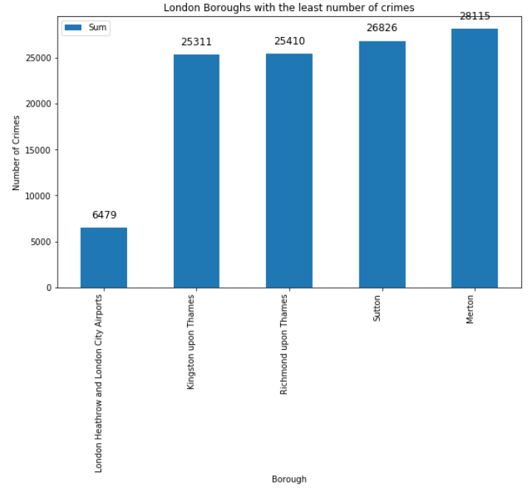
Slide 2
Bottom 5 Boroughs with highest crime incidents
Graph shows bottom 5 boroughs with crime rate
Airport areas has lowest crime rate (probably due to more security and also not a residential areas)
Airport areas are ignored in the scope of this project based on the assumption that there are no residential area in vicinity of Airport.
Kingston upon Thames is the Borough with lowest crime incident
8

Slide 9
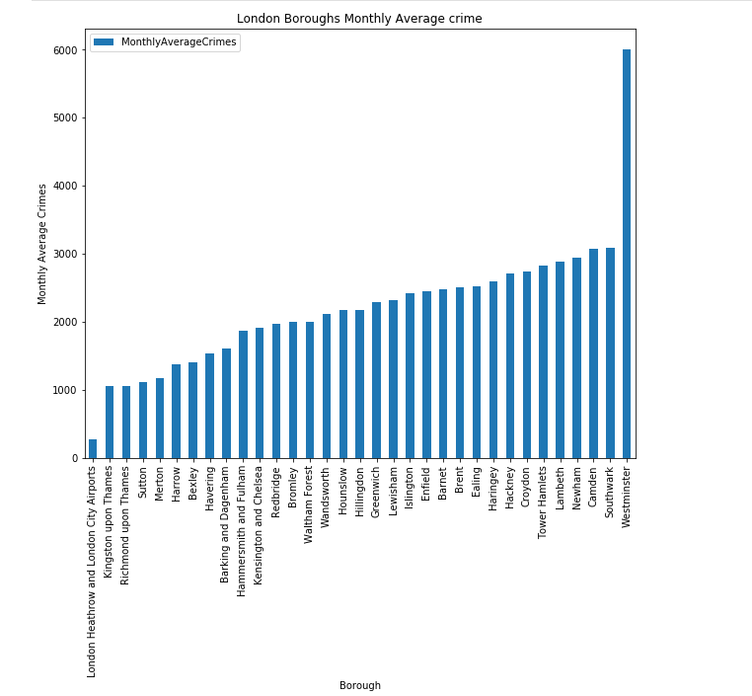
Slide 2
Monthly Average Crime Rates in London
Plot shows monthly average Crime rates in London
Westeminister has highest and Kingston upon Thames has lowest monthly average crime rate
Airport areas are ignored in the scope of this project based on the assumption that there are no residential area in vicinity of Airport.
9

Slide 10
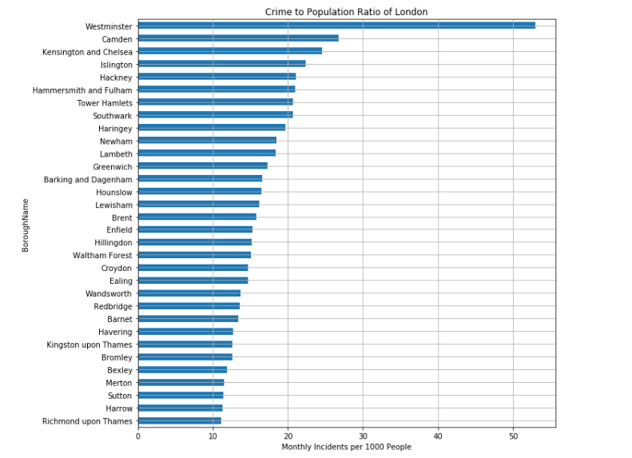
Slide 2
Crime to Population Ratio Incidents in London
Graph shows the crime rate for every 1000 people in London Boroughs
Westminster has highest crime rate for every 1000 people (probably due to more touristic attractions in the Borough)
Richmond upon Thames has lowest crime rate Ratio
10

Slide 11
Analyzing Data – Borough Data
11

Slide 12
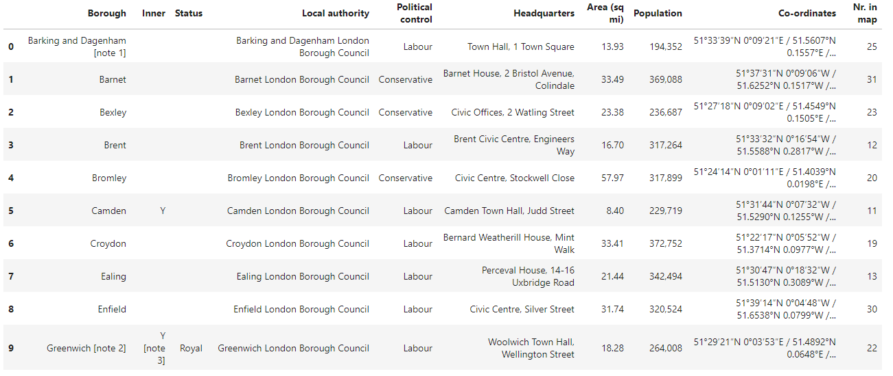
Slide 2
List of Boroughs in London
Data table from Wiki for list of borough in London
Size: (32,10)
12

Slide 13
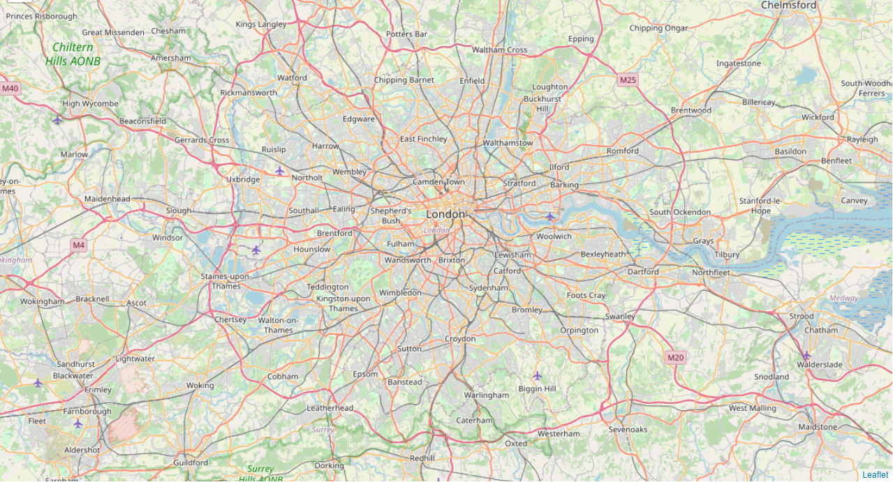
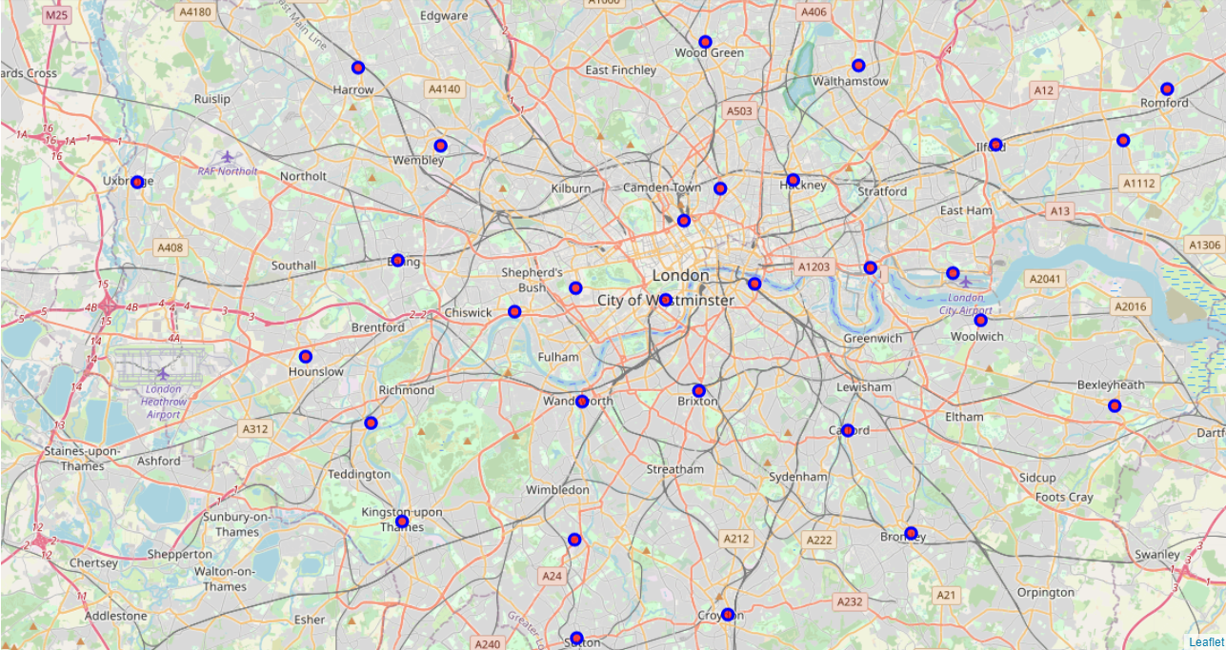
Slide 2
Boroughs in London
Map of City of London
Boroughs in London
13

Slide 14
Modeling
14

Slide 15
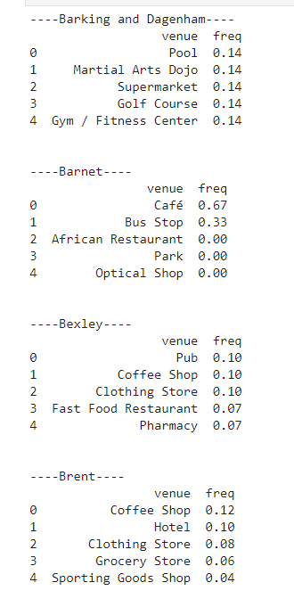
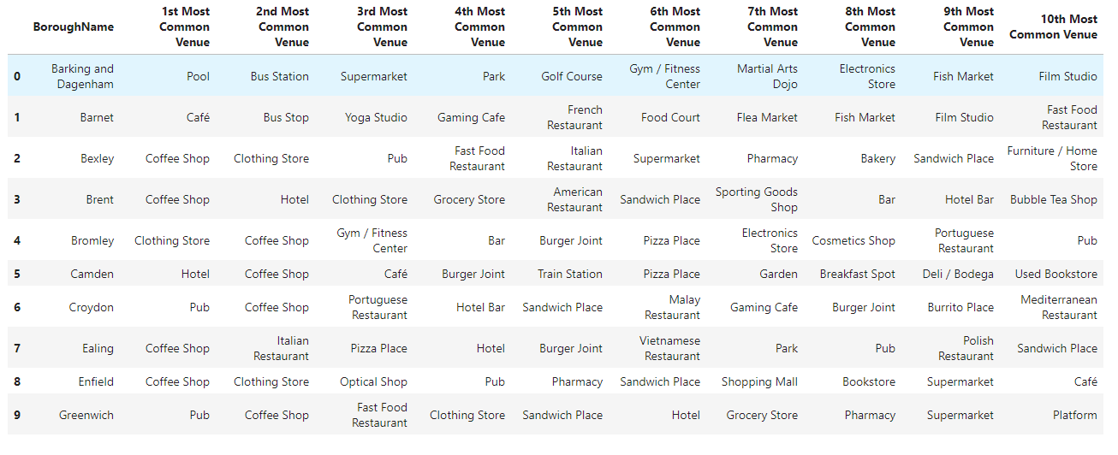
Slide 2
Popular Venues in each Borough
Using Foursquare APIs get top 50 venues and with one hot encoding method, find most popular venues in each Borough
There are total 179 unique venues in London
15

Slide 16
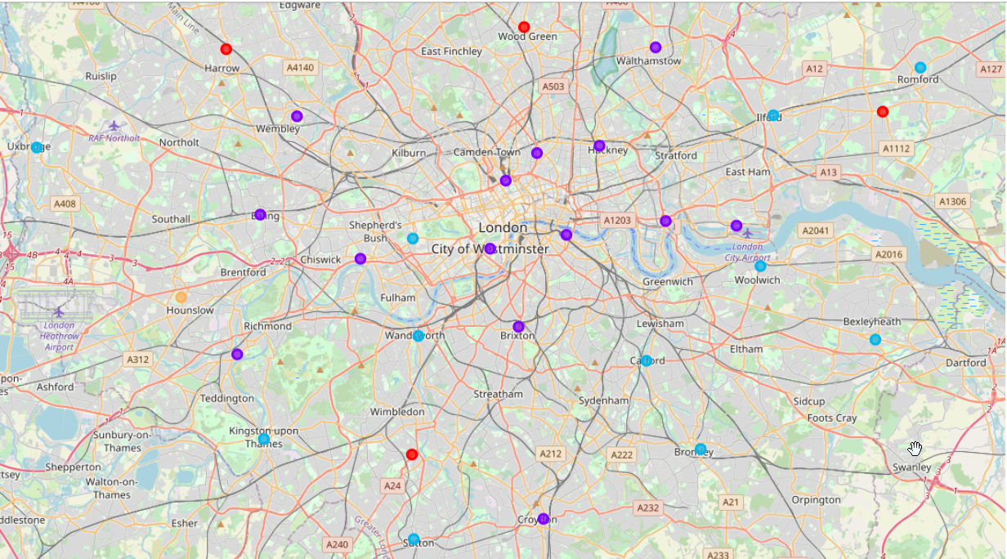
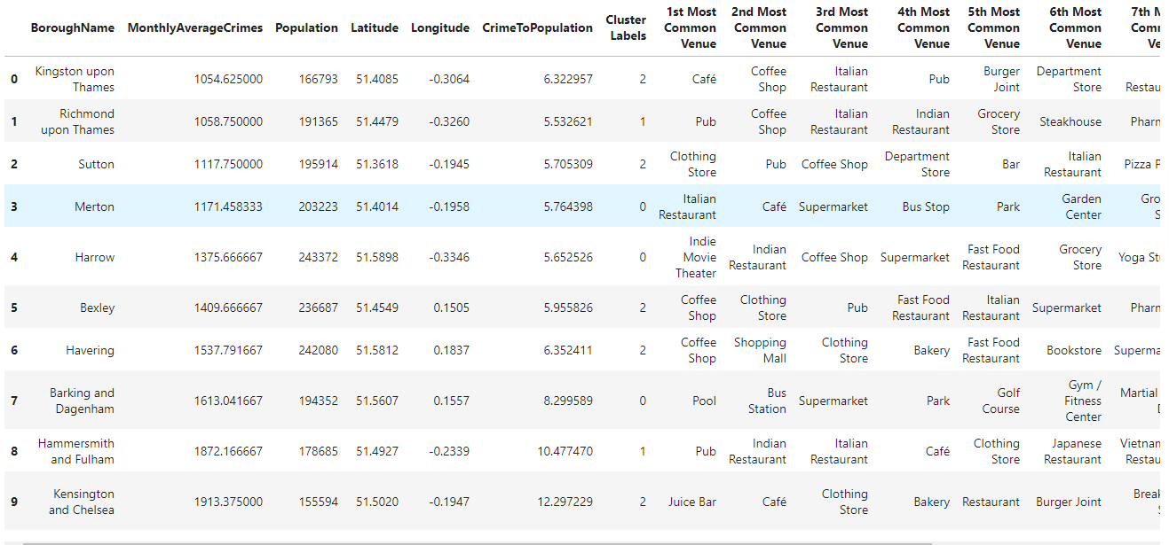
Slide 2
K means-clustering
Based on common Top 5 venues category, each borough are grouped into different(5) cluster as shown by different markers in Map
16

Slide 17
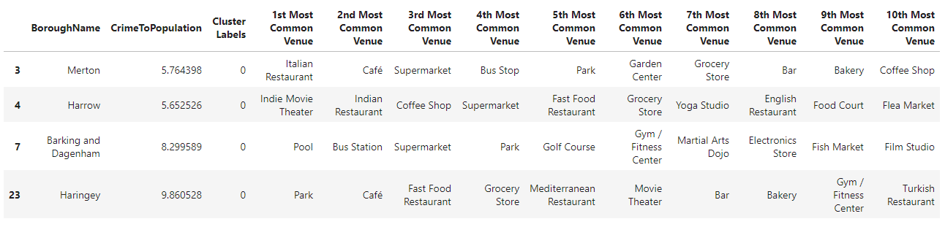
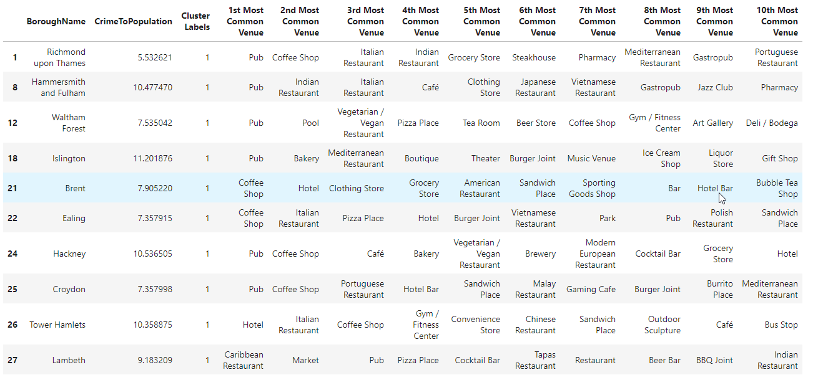
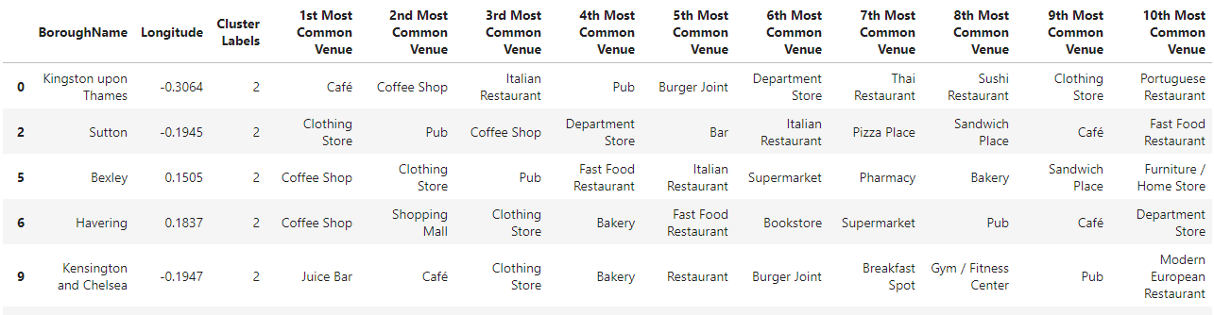
Slide 2
K means-clustering - Groups
Based on common Top 5 venues category, each borough are grouped into different(5) cluster as shown by different markers in Map
Cluster 1: Pools, Gyms, Cafes, Restaurants, Parks and Super Markets → Fitness Area
Cluster 2: Cafes, Pubs, Restaurants, Hotels → Lively Area
Cluster 3: Cafes, Stores, Shopping malls, fast foods → Busy Area
17

Slide 18
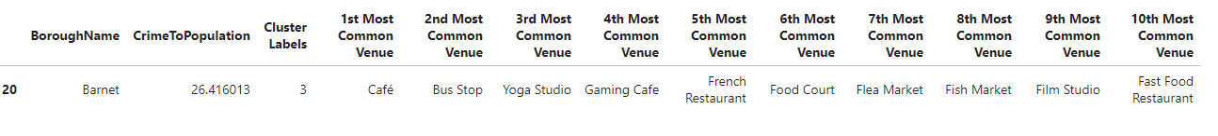
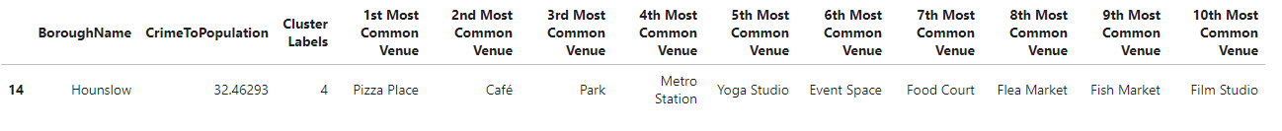
Slide 2
K means-clustering - Groups
Based on common Top 5 venues category, each borough are grouped into different(5) cluster as shown by different markers in Map
Cluster 4: Cafe, Bus stop, Yoga studio, Gaming Cafe → Quite Area
Cluster 5: Pizza Place, Cafe, parks, Metro Station → Noisy Area
18

Slide 19
Slide 2
K means-clustering - Groups
Based on common Top 5 venues category, each borough are grouped into different(5) cluster as shown by different markers in Map
Cluster 4: Cafe, Bus stop, Yoga studio, Gaming Cafe → Quite Area
Cluster 5: Pizza Place, Cafe, parks, Metro Station → Noisy Area
19

Slide 20
Results
20

Slide 21
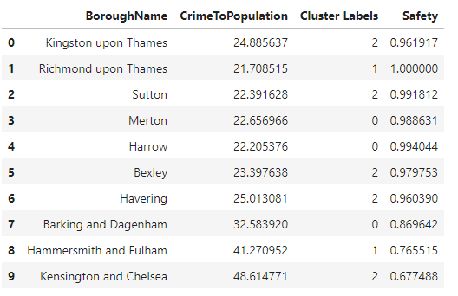
Slide 2
Saftey Score
For safety, normalizing the Crime to Population values → borough with score of 1 are safe places or less crime ration for 1000 people
21

Slide 22
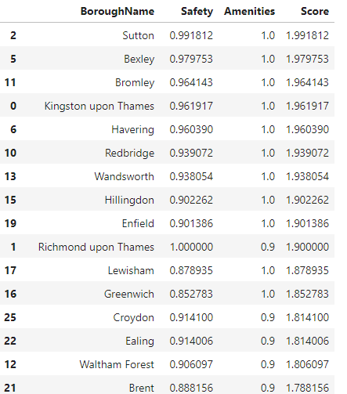
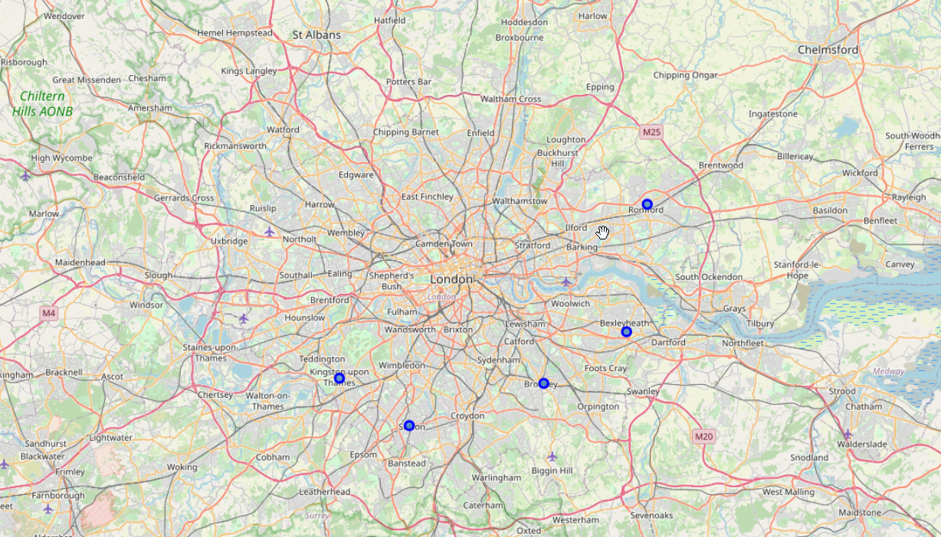
Slide 2
Best Amenities
For best facilities, score based on personal preference are provided in the data.
Highest score for Cluster 2 and lowest for Cluster 5
Adding Safety and Amenities score, we get to choose the best Borough
Sutton is good borough to move considering the safety and amenities together
22

Slide 23
Slide 2
Boroughs good to move-in
Based on the data analysis performed, following Boroughs can be good to relocate in London
Sutton
Bexley
Bromley
Kingston upon Thames
Havering
23

Slide 24
Slide 2
Conclusions
As seen in the map, the above boroughs are a bit far from Central London. It would take considerable amount of time to commute towards central London(assuming the work place location).
Moreover, we only considered venues which are popular and have reviews.
We could as well consider each borough individually and all the neighborhoods in each of borough to determine good location.
24

Slide 25
Slide 11
THANK YOU
Pic Source: By Tristan Surtel - Own work, CC BY-SA 4.0, https://commons.wikimedia.org/w/index.php?curid=83153416

